Slide 1

HELLO!
Here 1Crore Projects
I am here because I love to give presentations.
You can find me at @1CROREPROJECTS

Slide 2
Social Recommendation With Characterized Regularization

Slide 3

AIM OF PROJECT
In this main aim of the project was to leverage social relation data to improve recommended systems.

Slide 4
ABSTRACT
Social recommendation, which utilizes social relations to enhance recommender systems, has been gaining increasing attention recently with the rapid development of online social networks.
Existing social recommendation methods are based on the assumption, so-called social-trust, that users’ preference or decision is influenced by their social-connected friends’ purchase behaviors.

Slide 5
INTRODUCTION
Traditional recommender systems that learn user’s preference from only user-item interaction data often suffer from data sparsity and cold start problem, which worsens the recommendation performance. To be specific, these works adopt multi-task learning (MTL) to perform both the task of recommendation and social-link prediction at the same time. Then this term is combined with the objective function of learning from interactions, introducing social-relational data to the recommendation task.

Slide 6
EXISTING SYSTEM
Existing recommendation models we combine this regularization term with the objective function of learning from interaction data. The item-specific regularization term makes the constraint of embedding distance varies in different dimensions.
In this way, we can distinguish different similarity with different social-connected friends, which address the limitation of existing methods and make models more effective. Use the previous example, the CSR term helps make sure the user has similar food-taste with her family members.

Slide 7
DISADVANTAGES:
Decreases Face-to-Face Communication Skills.
General Addiction.
Privacy concerns.

Slide 8
PROPOSED SYSTEM
In this we proposed model can be applied to both social media based on the learning example sharing some useful information due to its high generality.
Social recommendation can potentially solve some challenging problems of traditional recommender systems such as the data sparsity problem and the cold-start problem, and has attracted broad attention from both academia and industry.

Slide 9
ADVANTAGES:
Higher conversions.
To learn more information
Increasing popularity of social media

Slide 10
ALGORITHM
Collaborative Filtering Algorithm:
Collaborative filtering is a technique that can filter out items that a user might like on the basis of reactions by similar users. It works by searching a large group of people and finding a smaller set of users with tastes similar to a particular user.

Slide 11
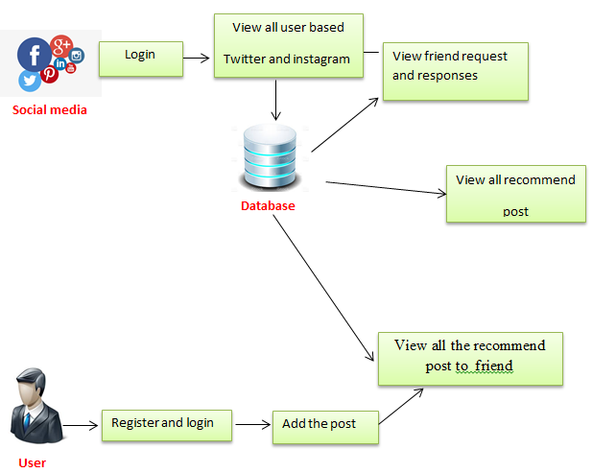
SYSTEM ARCHITECTURE

Slide 12
MODULES
In this project has two modules:
Social Media-Twitter and Instagram
Users

Slide 13
SOCIAL MEDIA:
Login the account with the correct credentials
View all users based on the twitter and Instagram and Authorize them.
Graph based on prediction.
Logout

Slide 14
USER:
Register the account with the basic information and select the social media
Login the account with the correct username and password
Add the posts based on the trending topic, awareness, news, useful information etc.
View all the post recommend to friends and also view recommended post by their friends
Recommendation based on the Interaction and the learning purpose.
Based on the post we find the who all are positive, negative vibes.
Logout

Slide 15
HARDWARE REQUIREMENTS
System | Intel i3 and above
Hard Disk | 40GB
RAM | Minimum 4GB
Processor | 64-bit, four-core, 2.5 GHz minimum per core

Slide 16
SOFTWARE REQUIREMENTS
Front End Language | HTML, CSS, JAVA, JSP SERVELTS
Backend | My SQL
Operating System | Windows 10 or 11
IDE | JAVA DEVELOPEMENTKIT

Slide 17
FUTURE WORK
In future, we plan to extend our proposed CSR to more complicated models.

Slide 18
CONCLUSION
This work contributes to a new solution for social recommendation. We argue the traditional assumption of social trust is not reasons from multiple perspectives.
We develop a novel design of a regularization term for leveraging social relations in collaborative filtering.

Slide 19
REFERENCE
[1] Z. Huang, H. Chen, and D. Zeng, “Applying associative retrieval techniques to alleviate the sparsity problem in collaborative filtering,” ACM Transactions on Information Systems (TOIS), vol. 22, no. 1, pp. 116–142, 2004.
[2] A. Popescul, D. M. Pennock, and S. Lawrence, “Probabilistic models for unified collaborative and content-based recommendation in sparse-data environments,” in Proceedings of the Seventeenth conference on Uncertainty in artificial intelligence (UAI). Morgan Kaufmann Publishers Inc., 2001,
[3] J. Tang, X. Hu, and H. Liu, “Social recommendation: a review,” Social Network Analysis and Mining, vol. 3, no. 4, pp. 1113–1133, 2013.

Slide 20
THANKS!
Any questions?
You can find me at
Reach us – 1croreprojects@gmail.com
Contact / Whatsapp: 7708 150 152 / 9751 800 789 / 790 432 0834

